Slide 1
Virtual Clothes Try-on
Team 38:
Jorge Olivares
Robin Martinez
Alan Vela

Slide 2
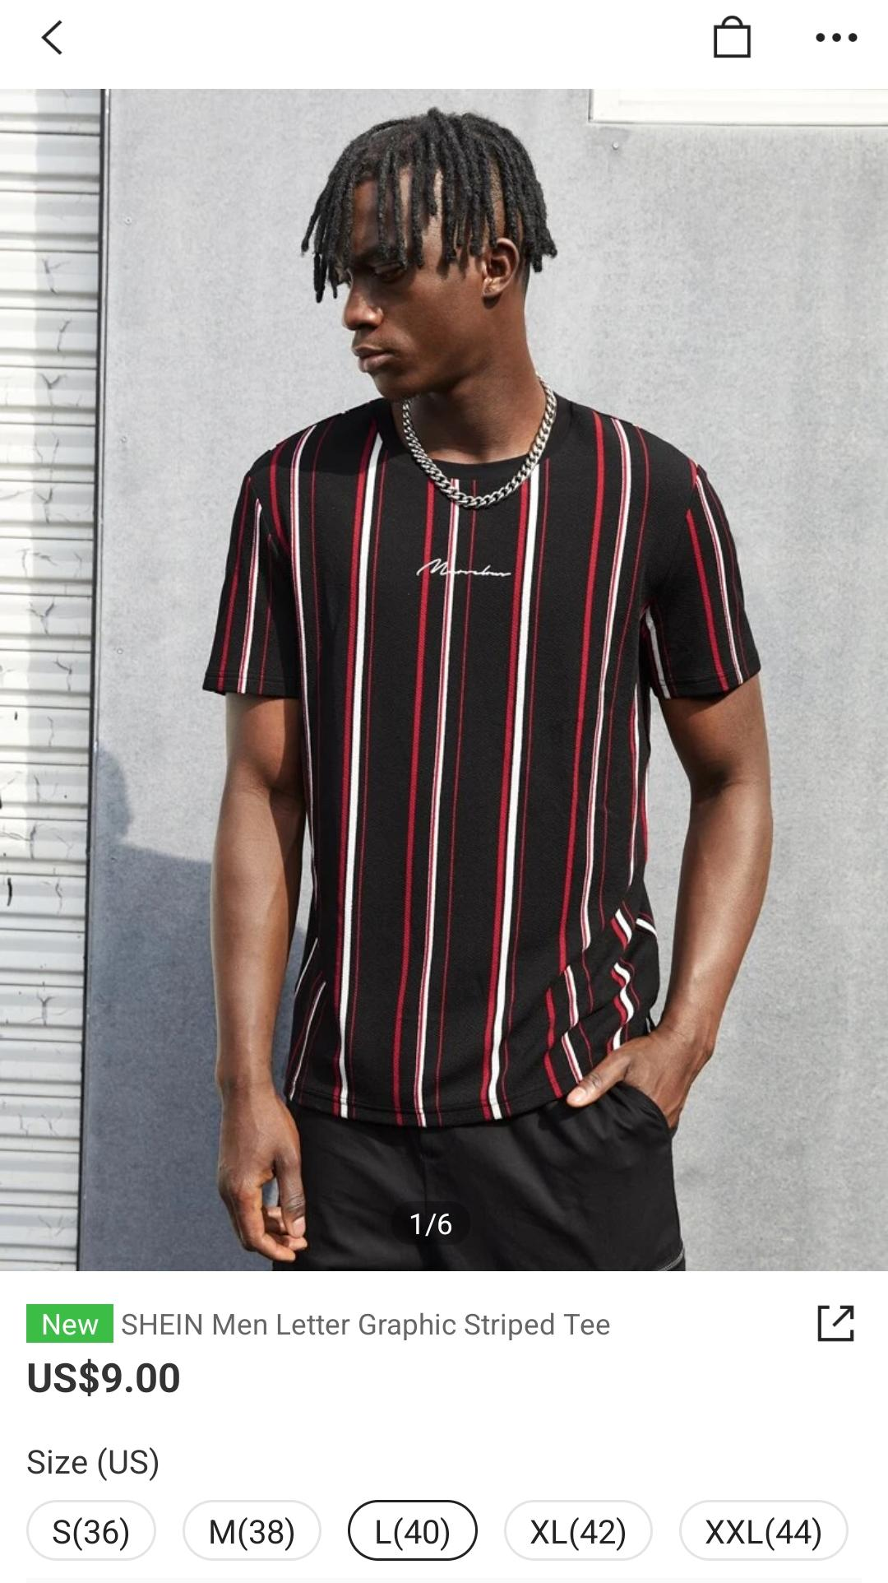
Execution Summary
Problem Statement
Online shopping is in an all time high, but clothes return is a 30% of the purchases done.
Returns make the company lose money and several of the products end up in the landfill.
The Clothing Virtual Try-On Application will…
Provide a medium through which clothing catalogs can be accessed
Reduce the amount of returns on unsatisfactory sales
Sell upcoming lines, allows for pre-ordering of clothes

Slide 3
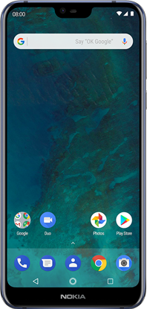
Neural Network
UI
Application Design
Pose Reconstructor
Shape Estimation
Clothing Database
Texture Map Generation
Clothing Companies
User with application
Green - Robin Martinez, Blue - Alan Vela, Red - Jorge Olivares, Purple - End Consumer

Slide 4

Android Application Subsystem
Using Android Studio for GUI
Aesthetic look for application interaction
Shows avatar of user
Communicates with cloud server

Slide 5
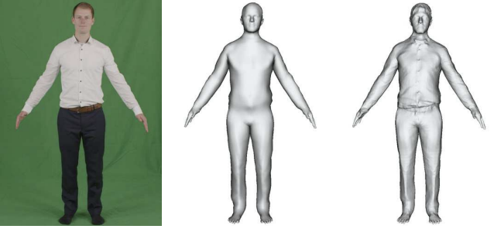
Machine Learning Subsystem
Consists of 3 steps:
Pose reconstruction
Consensus shape estimation
Frame refinement and texture map generation

Slide 6

Cloud Database Subsystem
Use of Amazon Web Services
MySQL for data storage and retrieval
Save User with 3D model texture.
Store and provide access for different clothes design.

Slide 7
Execution and Validation
 | March 5 | March 19 | April 2 | April 16 | April 30
Android Application Subsystem | Learning Android Studio & GUI 25% | Comms w/ Database & GUI 60% | Info to cloud server | Info from cloud server | GUI 95% & Testing
Cloud Database | Establishing host for the cloud | SQL database setup | Designs of clothing textures | Populate database | Testing data retrieval
Machine Learning Subsystem | Verifying executable of original neural network | Translating original network to python 3 (33%) | Translating original network to python 3 (66%) | Translating original network to python 3 (100%) | Training the neural network and verifying outputs

Slide 8
Questions?

